Slide 1
National College of Engineering
Affiliated to Tribhuvan University
A Minor Project Presentation On
Wildfire Monitoring System Using CatBoost and LSTM Hybrid Framework
Presented To:
Department of Electronics and Computer
Engineering, NCE
Presented By:
Aayush Kandel
Bishal Gyawali
Jonish Thapaliya
Prabhat Rawal
[NCE079BCT001]
[NCE079BCT009]
[NCE079BCT013]
[NCE079BCT022]

Slide 2
Outline
Introduction
Problem Statement
Objectives
Related Theory and Literature Review
Methodology
Work Flow
Task Accomplished
Remaining Tasks
References

Slide 3
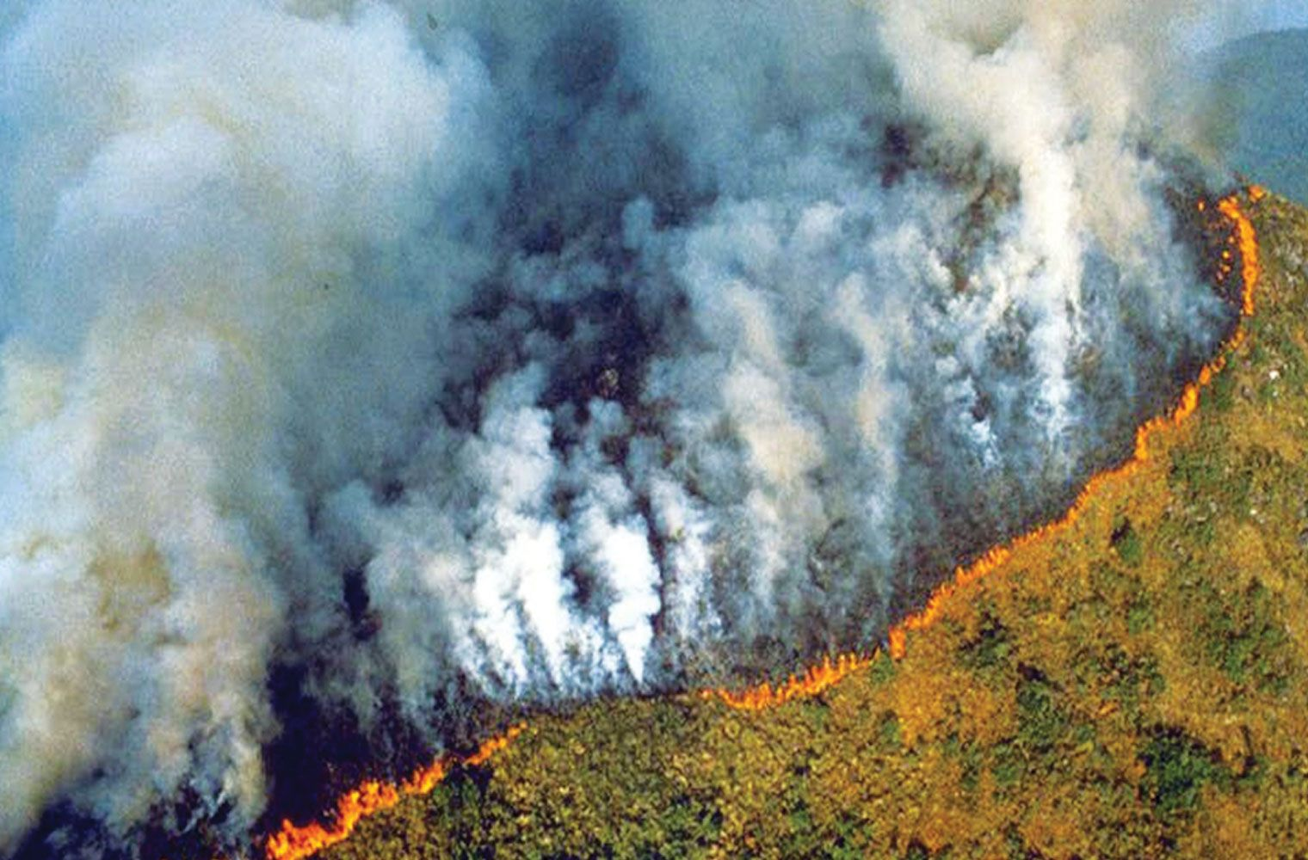
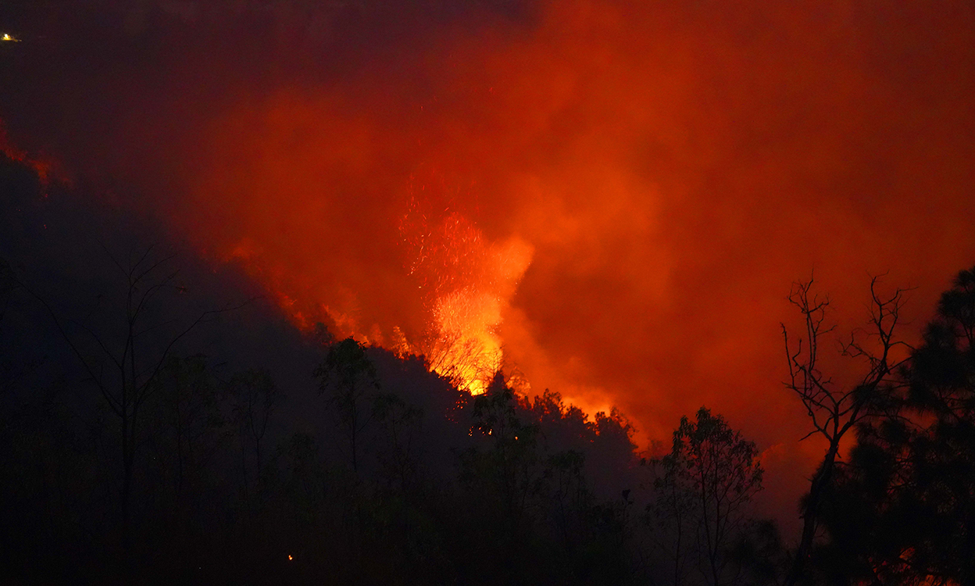
Introduction
Forest fires are a major global environmental threat, affecting regions from Siberia and the Amazon to the Himalayan–Hindu Kush (HKH) region.
Recent mega-fires in Australia, Brazil, USA, Greece, and Indonesia have caused severe ecosystem damage.
Forest fires significantly contribute to climate change through large-scale carbon emissions.
A 2°C rise in global temperature has
increased the frequency and intensity
of forest fires.
Figure 1: Recent Mega-Fires Observed in the Amazon Forest and Taplejung "Nepal"
[Source : Amazon Forest Fire / Images – Ratopati / Nepal Fire images/ Taplejung ]

Slide 4
Problem Statement
Focus is Reactive: Current systems prioritize post-ignition detection over proactive forecasting.
The "Gap": Present Technology answers, "Where is the fire now?" instead of "Where will it be?".
Data Limitations: Heavy reliance on static/historical data with a lack of real-time dynamic inputs.[6, 7].
Operational Gap: Missing the critical window for proactive prevention and resource positioning.

Slide 5
Objectives
To develop an AI-powered forest fire occurrence prediction system (FFOPM) that integrates satellite remote sensing, topographic, vegetation, and meteorological data to classify daily fire risk levels using CatBoost ensemble learning approach.
To design a forest fire spread forecasting model (FFSFM) using LSTM networks that predicts spatial-temporal fire propagation patterns and provides actionable intelligence through an integrated web-based visualization platform for proactive fire management.

Slide 6
Literature Review
[ Table no 5.a : Summary of Related Works on Forest Fire Detection and Prediction with Identified Area of Improvement ]
S.N | Name Of The Article | Authors | Problem Addressed | Area of Improvement
1. | A forest fire detection system based on ensemble learning | Xu et al.(2023) | Detection of forest fires using ensemble learning on a custom, diverse image dataset. | Slight precision/recall trade-offs occur due to the misclassification of some fire images by the Efficient Net backbone.
2. | A forest fire prediction model based on cellular automata and machine learning | Sun et al.(2024) | Predicting forest fire spread behaviour (FFSBP) by integrating Cellular Automata, the Wang Zhengfei model, and ensemble learning. | The model’s accuracy is constrained by its reliance on historical data without real-time combustion experiments.
3. | Ensemble learning methods for burned area prediction in California and Portugal forests | Xie and Peng et al.(2023) | Predicting the size of the burned area using ensemble learning (Random Forests, XG-Boost) and comparing performance against established models. | The study is limited by its reliance on historical data, particularly regarding the accuracy of Support Vector Machines (SVMs) for small fires.

Slide 7
Literature Review
[ Table no 5.b : Summary of Related Works on Forest Fire Detection and Prediction with Identified Area of Improvement ]
S.N. | Name Of The Article | Authors | Problem Addressed | Area of Improvement
4 | Mapping climate change induced forest fire susceptibility using tree-based machine learning algorithms in Bangladesh | Haydar et al.(2025) | Mapping forest fire susceptibility and projecting the increase in high-susceptibility areas under future climate change scenarios. | Predictions are limited by uncertainties inherent in climate models (specifically regarding future projections under the RCP 8.5 scenario).
5. | Satellite data for forest fire detection using deep learning | Hannane et al.(2023) | Analysing forest fire detection accuracy using a deep learning-based Multiscale-net model on Landsat-8 satellite data. | Potential for false positives and negatives depending on the specific combination of input bands and kernel sizes, impacting overall reliability.

Slide 8
Methodology
1. Data Acquisition & Preprocessing
Data Sources:
  Near-Real-Time Fire: NASA FIRMS (MODIS, VIIRS).
  Static Risk Factors: Topography (DEM), Vegetation/Fuel Type (Land Cover).
  Dynamic Factors: Live Weather Data (Wind, Humidity, Temperature).
Platform: Data acquisition and initial processing managed via Google Earth Engine (GEE).
Preprocessing Steps:
  Synchronize static, dynamic, and fire alert data to a unified spatio-temporal grid.
  Feature Engineering: Derive key metrics like Fire Radiative Power (FRP) and time-since-last-rain.

Slide 9
Methodology
2. Model Development & Training
Phase 1: Instant Detection (Pre-Forecast)
  Model: CatBoost (Trained on static factors + initial satellite/weather snapshots).
Phase 2: Adaptive Forecasting (Post-Forecast)
  Model: CNN- LSTM & Catboost Hybrid (Trained on fire perimeter, weather, topography).
  Input: Sequence of 2D grid features.
  Output: Predicted 2D fire spread map.
3. Unified System Integration
Deployment: Modules are containerized using Docker
Interface: Web-based visualization of real-time detection and fire spread forecasts.

Slide 10
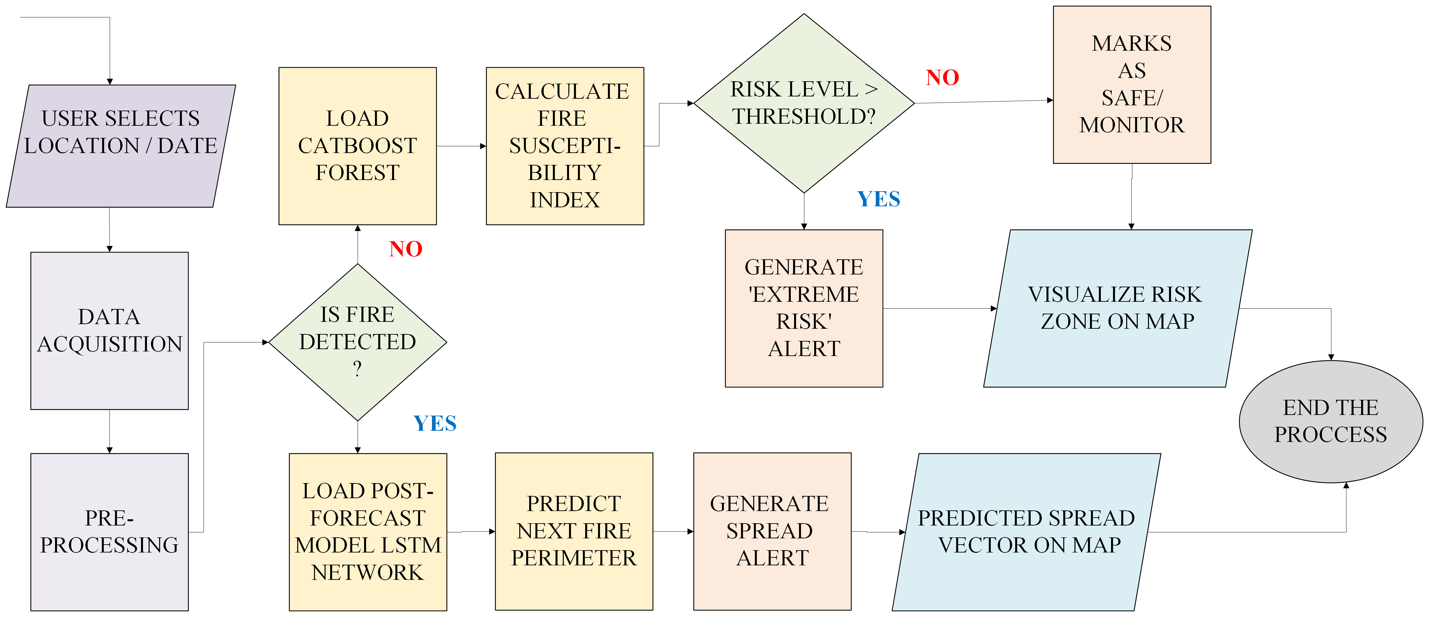
System Flowchart
[ Figure 6 : System Workflow - " Flowchart" ]

Slide 11

Task Accomplished
7.1. Location : Surkhet, Banke, Bardiya, Dang, Salyan
High Fire Frequency (Hotspots): Records of the highest numbers of "fire alerts" every year.
Wildlife & Biodiversity Risk: Bardiya and Banke National Parks.
Difficult Geography: Steep slopes in Surkhet and Salyan cause fires to
move uphill at extreme speeds. - " Chimney Effect ".
Extreme Climate & Fuel: High temperatures
(40°C+) In Dang and Banke turn
dense Sal leaf litter into a highly
flammable natural tinderbox.
[ Table no 5.a : Forest Area distribution per district ]
[ Source :Department of Forest Research and Survey, Nepal ]

Slide 12
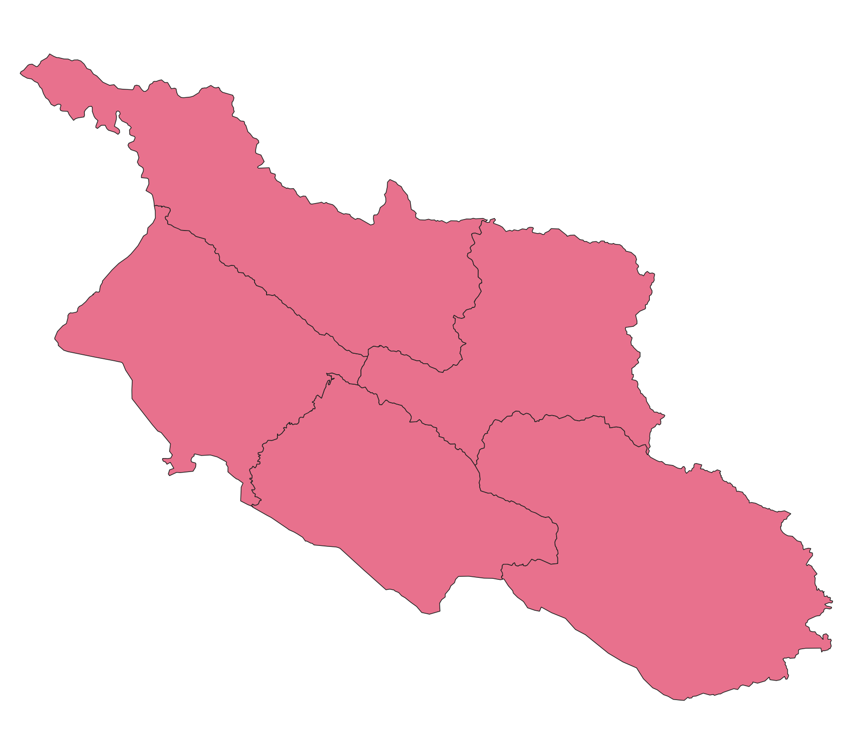


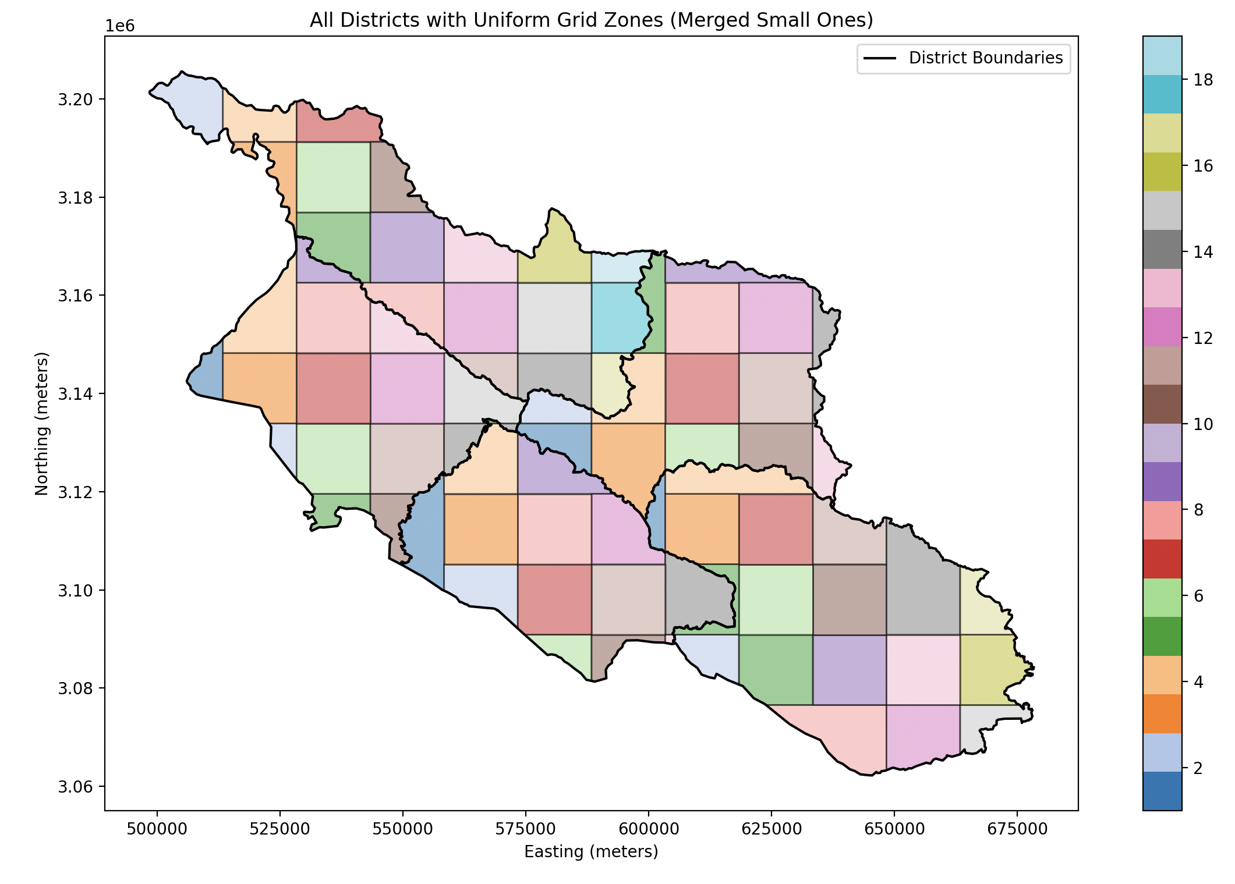
Task Accomplished
7.2. Spatial Analysis & Zone Divison
Tools Used : QGIS , Python
Spatial Analysis: converts vague district borders into precise 'action zones', used to calculate the exact area pinpoint exact location.
Zone Divison: Transforms diverse administrative areas into standardized "data pixels," used to pinpoint localized fire risks and calculate precise fire density.
Logic Used: Grid-Based Spatial Partitioning
Banke - 14 zones
Bardiya - 15 zones
Surkhet - 19 zones
Dang - 17 zones
Salyan - 14 zones
[ Figure : Spatial Analysis and Zonal Distribution
of District with partitioning ]

Slide 13
Task Accomplished
7.3. Data Collection & Pre-Processing :
Source : Google Earth Engine
[ Table no 7.3.a : Dataset link with respective data layers and revisit frequencies ]​
SN. | Dataset Link | Data layers | Satellite | Revisit Frequency
1. | Mod14a1 | Bands : fire mask ( 7: Fire (low confidence, land or water) 8: Fire (nominal confidence, land or water) 9: Fire (high confidence, land or water)) | Terra | Daily (Twice a day: Day & Night)
2. | Sential ( La2) | Bands : (B2, B3, B4, B8, B11, B12) masking : SCL / MSK_CLDPRB | Sentinel-2A & 2B | 5 Days (Combined constellation)
3. | USGS Landsat | Bands : (B2, B3, B4, B8, B11, B12) | Landsat 8 & 98 Days | 8 Days (Combined) 16 days each

Slide 14
Task Accomplished
[ Table no 7.3.b : Dataset link with respective data layers and revisit frequencies ]​
SN. | Dataset Link | Data layers | Satellite | Revisit Frequency
5. | MODIS - Terra+Aqua LST (Land Surface Temperature) | Bands : LST_Day_1km, LST_Night_1km masking : QC_Day (Bits 0-1), QC_Night (Bits 0-1), Clear_day_cov, Clear_night_cov | Terra & Aqua | Daily (Up to 4 times per day total)
6. | SRTM | Bands : elevation | Space Shuttle EndeavourStatic | (One-time mission in Feb 2000)
7. | Era - 5 Land | Bands : temperature_2m,dewpoint_temperature_2m,skin_temperature, soil_temperature_level_1,volumetric_soil_water_layer_1,total_precipitation_sum,u_component_of_wind_10m,v_component_of_wind_10m,surface_pressure) | ECMWF Model | Hourly (Aggregated to Daily)

Slide 15
Task Accomplished
7.4 Data Feature Engineering
Static Features (Terrain) :
Source: NASA SRTM DEM
Features: Elevation statistics (mean, p10, p90, std) , Slope metrics , Aspect metrics ,MTPI (topographic position index)
Spectral Vegetation Indices :
Source: Copernicus Sentinel-2 , USGS Landsat
Features: NDVI ,GNDVI , NBR , NDWI , EVI , SAVI , Composite NDVI , Vegetation quality flag
Temporal Lag Engineering:
Features: NDVI_lag1, lag3, lag7, lag14 ,Precipitation_lag30 , VPD_lag14 , Soil moisture lag , Rolling 30-day rainfall

Slide 16
Task Accomplished
Meteorological Engineering:
Source: ERA5
Variables: Air temperature, Soil temperature , Soil moisture, Relative humidity, Vapor Pressure Deficit(VPD),Wind speed & direction ,Surface pressure
Temporal Expansion: Lag features (1, 3, 7, 14 days) ,Rolling precipitation sums (7, 14, 30 days)
Methods Used :
KNN imputation (LST)
Median imputation (weather)
30-day vegetation interpolation
Feature Quality filtering & Missing FLags
Memory reduction 55%.
Data Classification
Train : 2000-2018
Validate: 2018-2020
Test-2021-2025
Master Table Formation
Range : 2000 – 2025
Format : .csv file
Total data : 7,11,237
Total fire day data : 4,988
Total no fire day data : 7,06,249

Slide 17
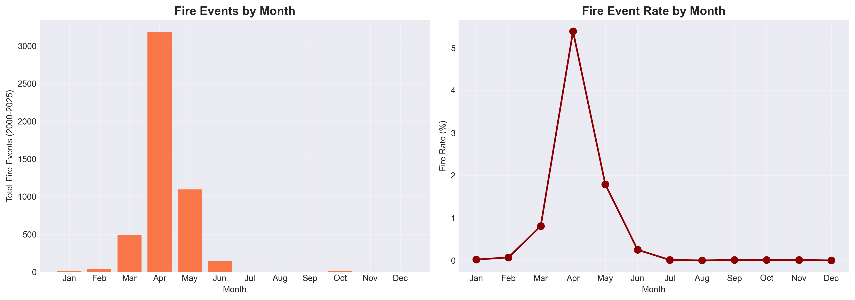
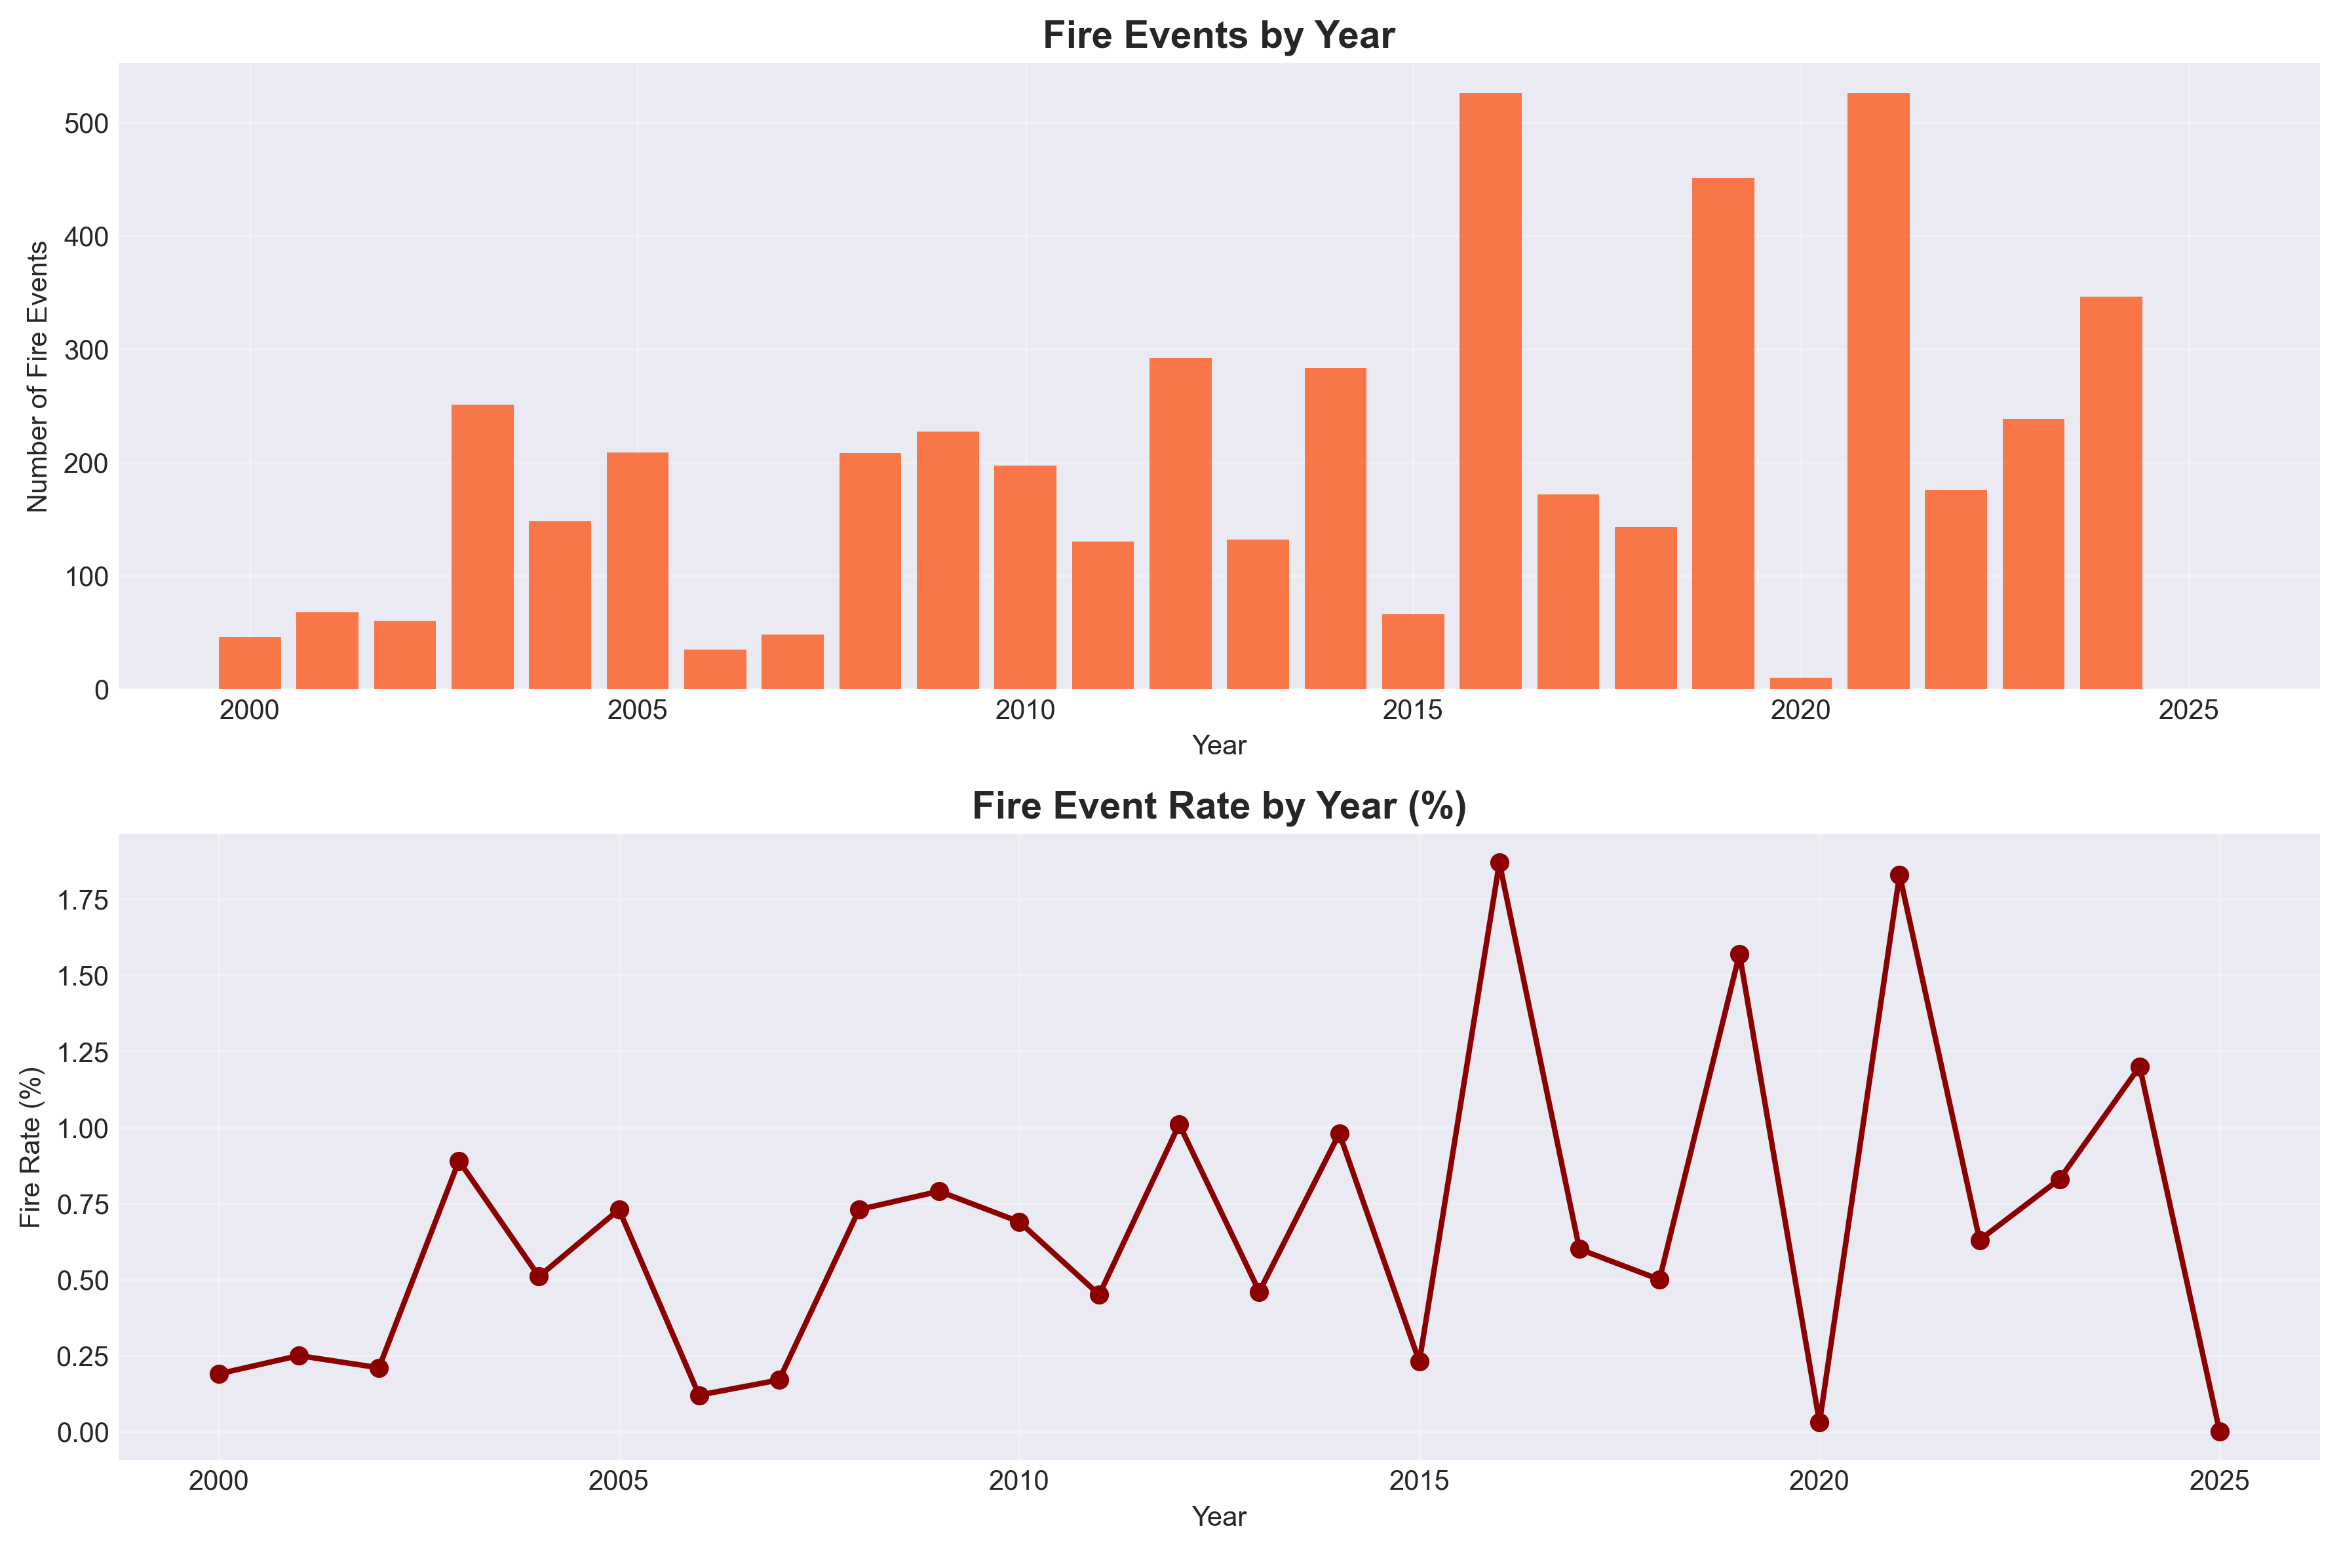
Task Accomplished
7.4.b Exploratory Data Analysis
[ Figure 7.4.b.i : Fire events classified by year and Month ]

Slide 18
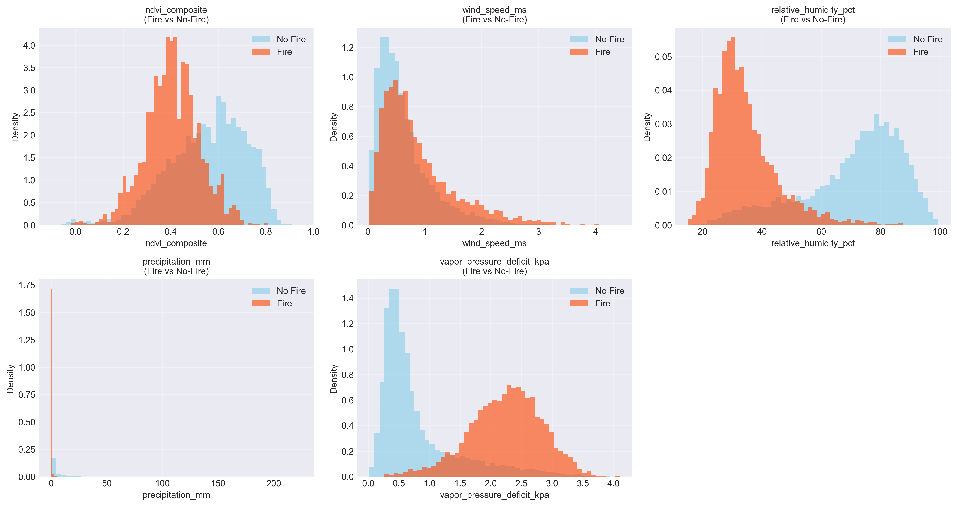
Task Accomplished
[ Figure 7.4.b.ii : Distribution density of key environmental features active fire events & no fires ]

Slide 19
Task Accomplished
7.5. FFOPM MODEL
a. Model Evaluation Metrices:
ROC-AUC: Measures the model’s overall ability to distinguish between fire and no-fire across all thresholds.
PR-AUC : Measures how well the model balances precision and recall for the fire class in imbalanced data.
Recall (Fire Class) : Percentage of actual fire events correctly identified by the model.
Precision : Percentage of predicted fire events that were actually true fires.
F1 Score: Harmonic mean of precision and recall, balancing false alarms and missed fires.
False Alarm Rate: Percentage of no-fire days incorrectly predicted as fire.
Specificity: Percentage of no-fire days correctly identified as no-fire.

Slide 20
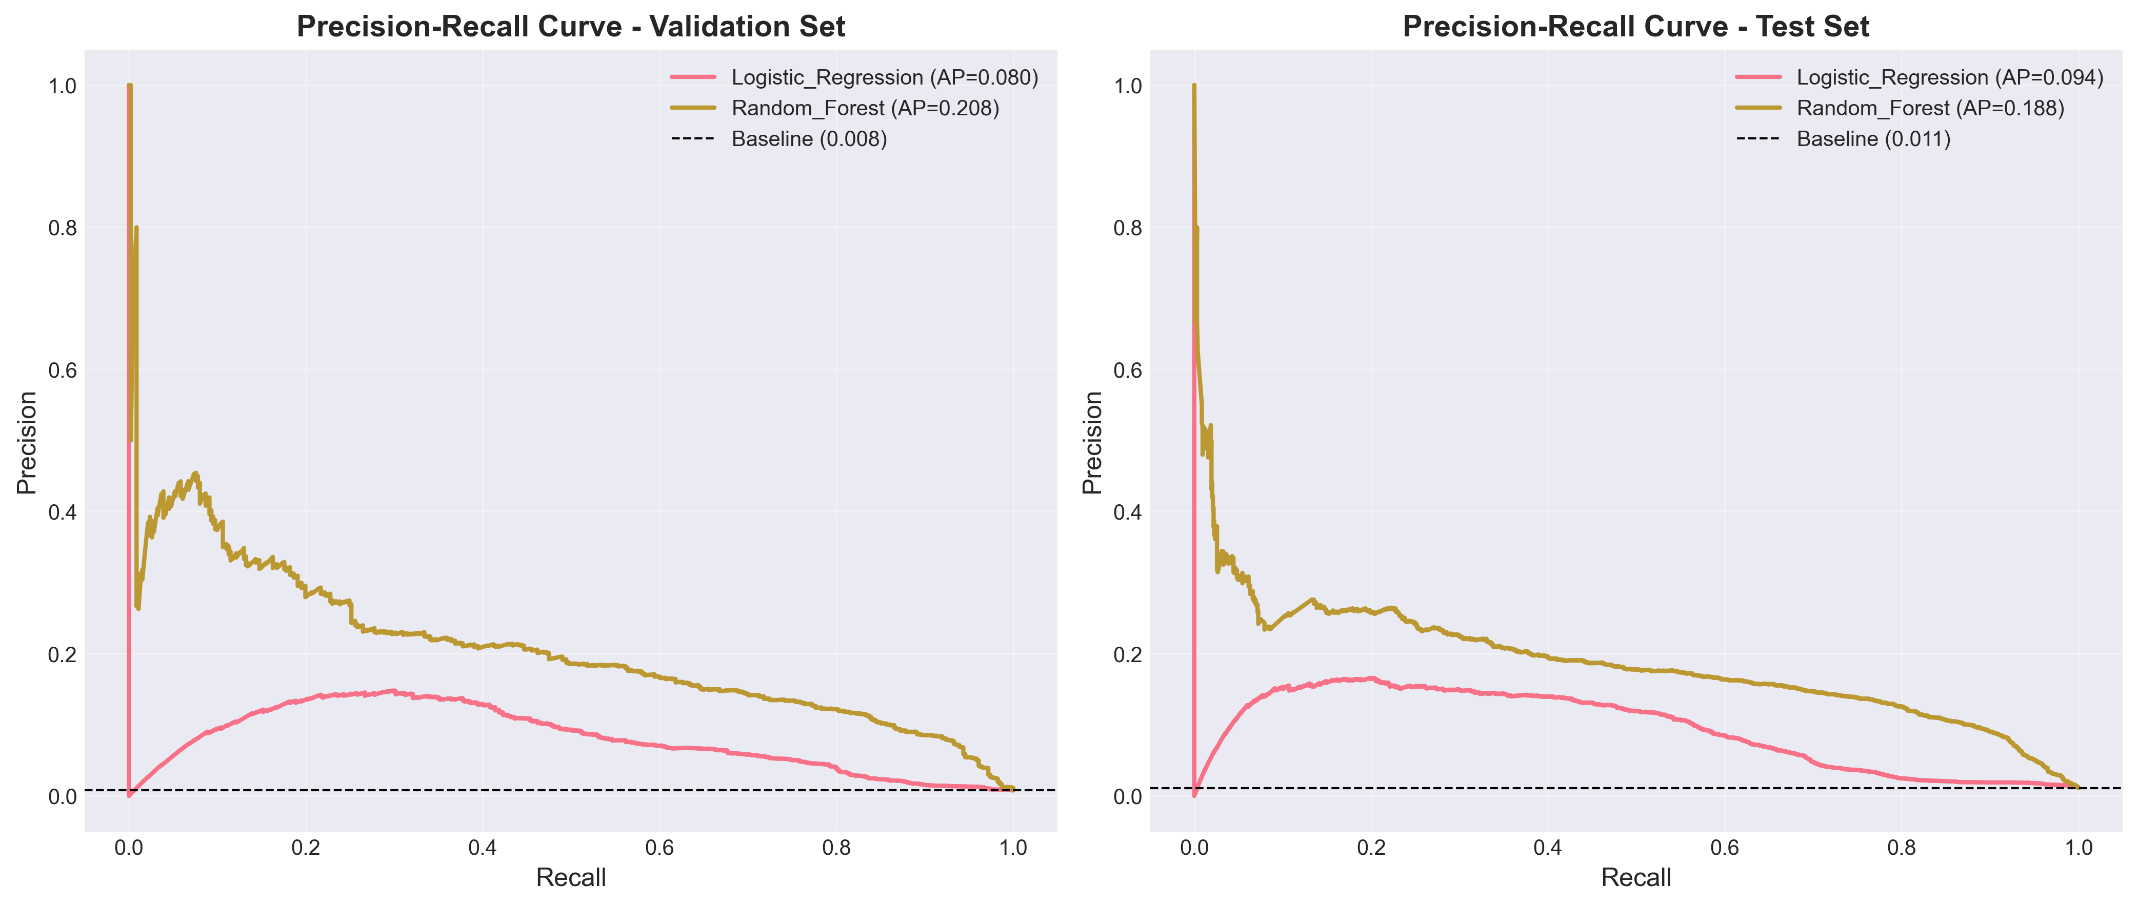
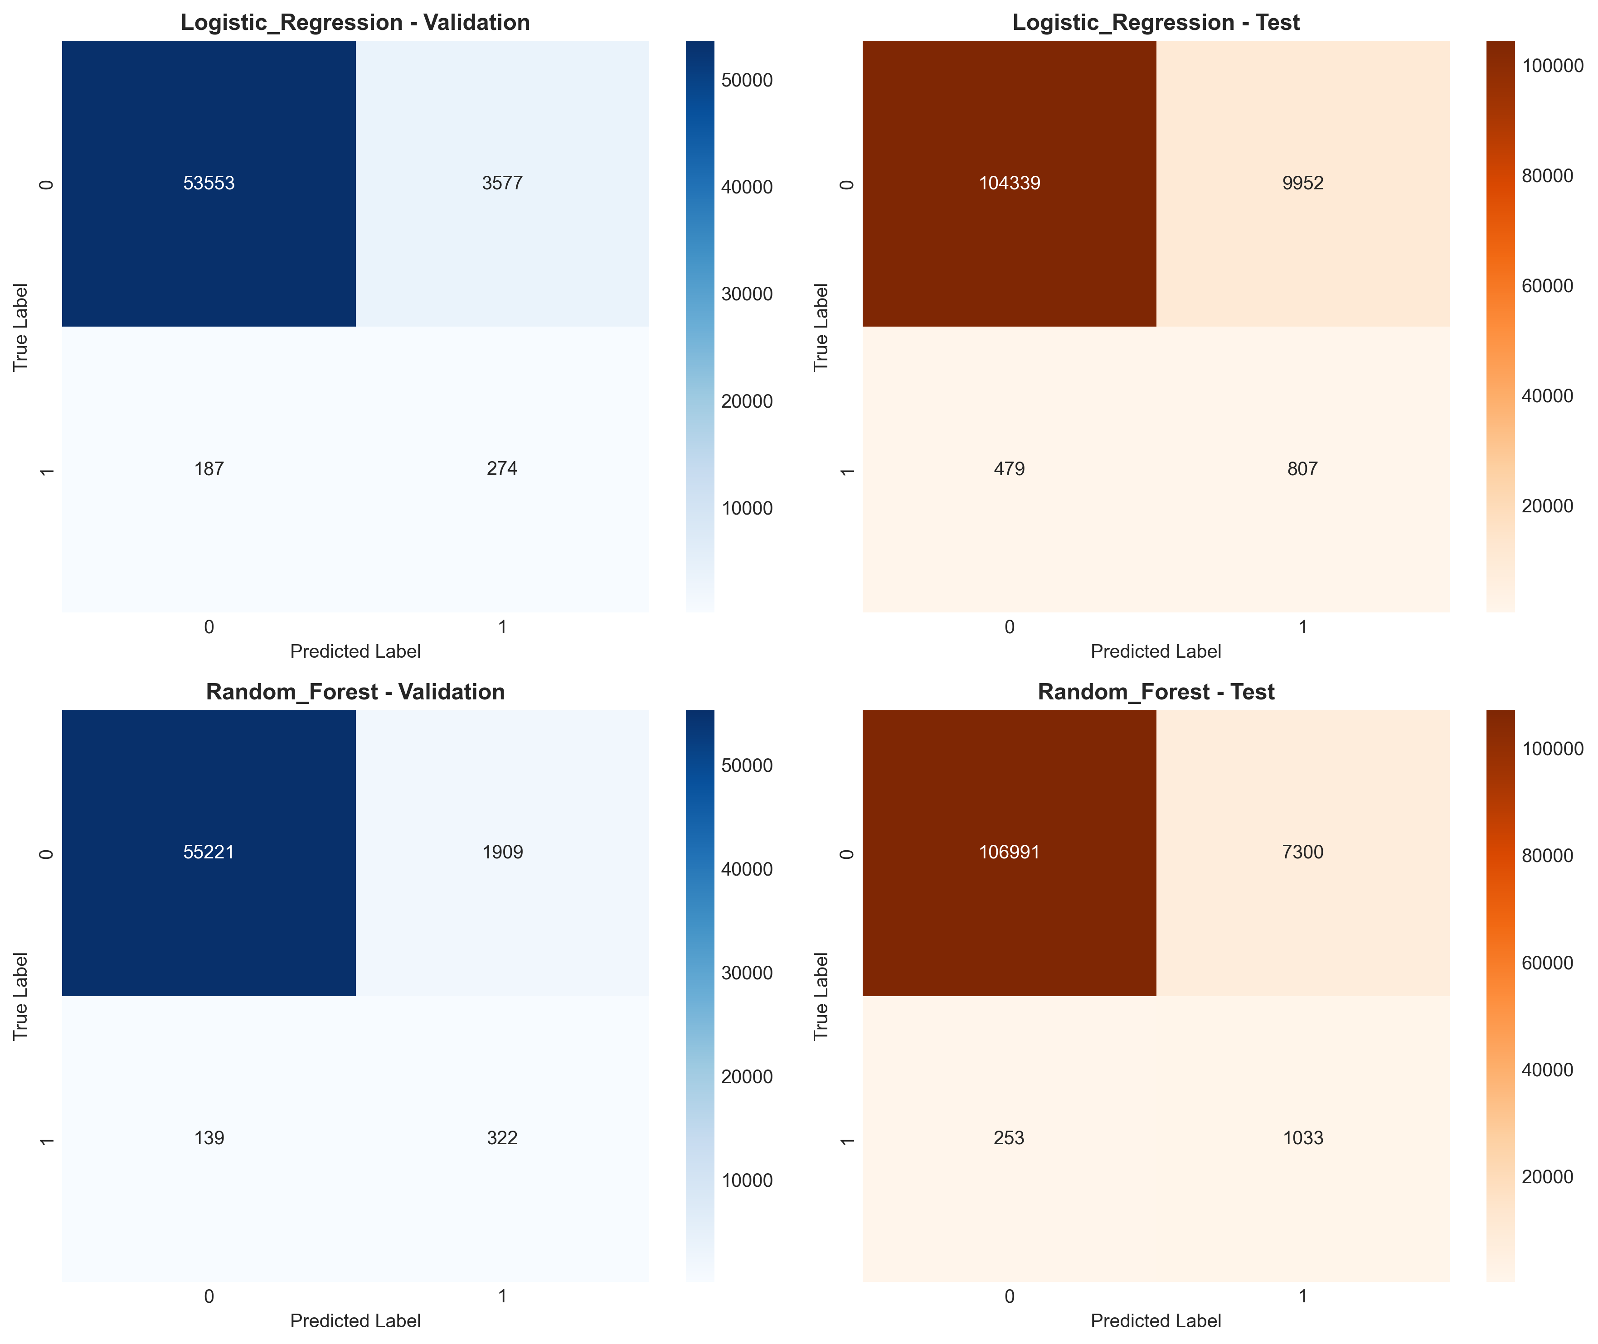
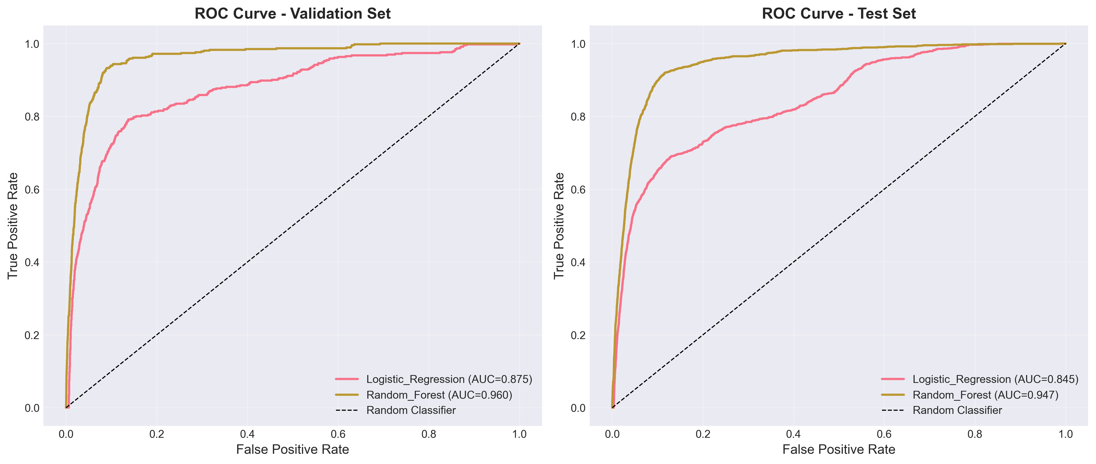
Task Accomplished
7.5.b Model Selection Strategy :
Logistic Regression (baseline)
Random Forest
[ Figure 7.5.b.i : Confusion Matrix / ROC / Precision Recall Curve – logistic Regression, Random Forest ]

Slide 21
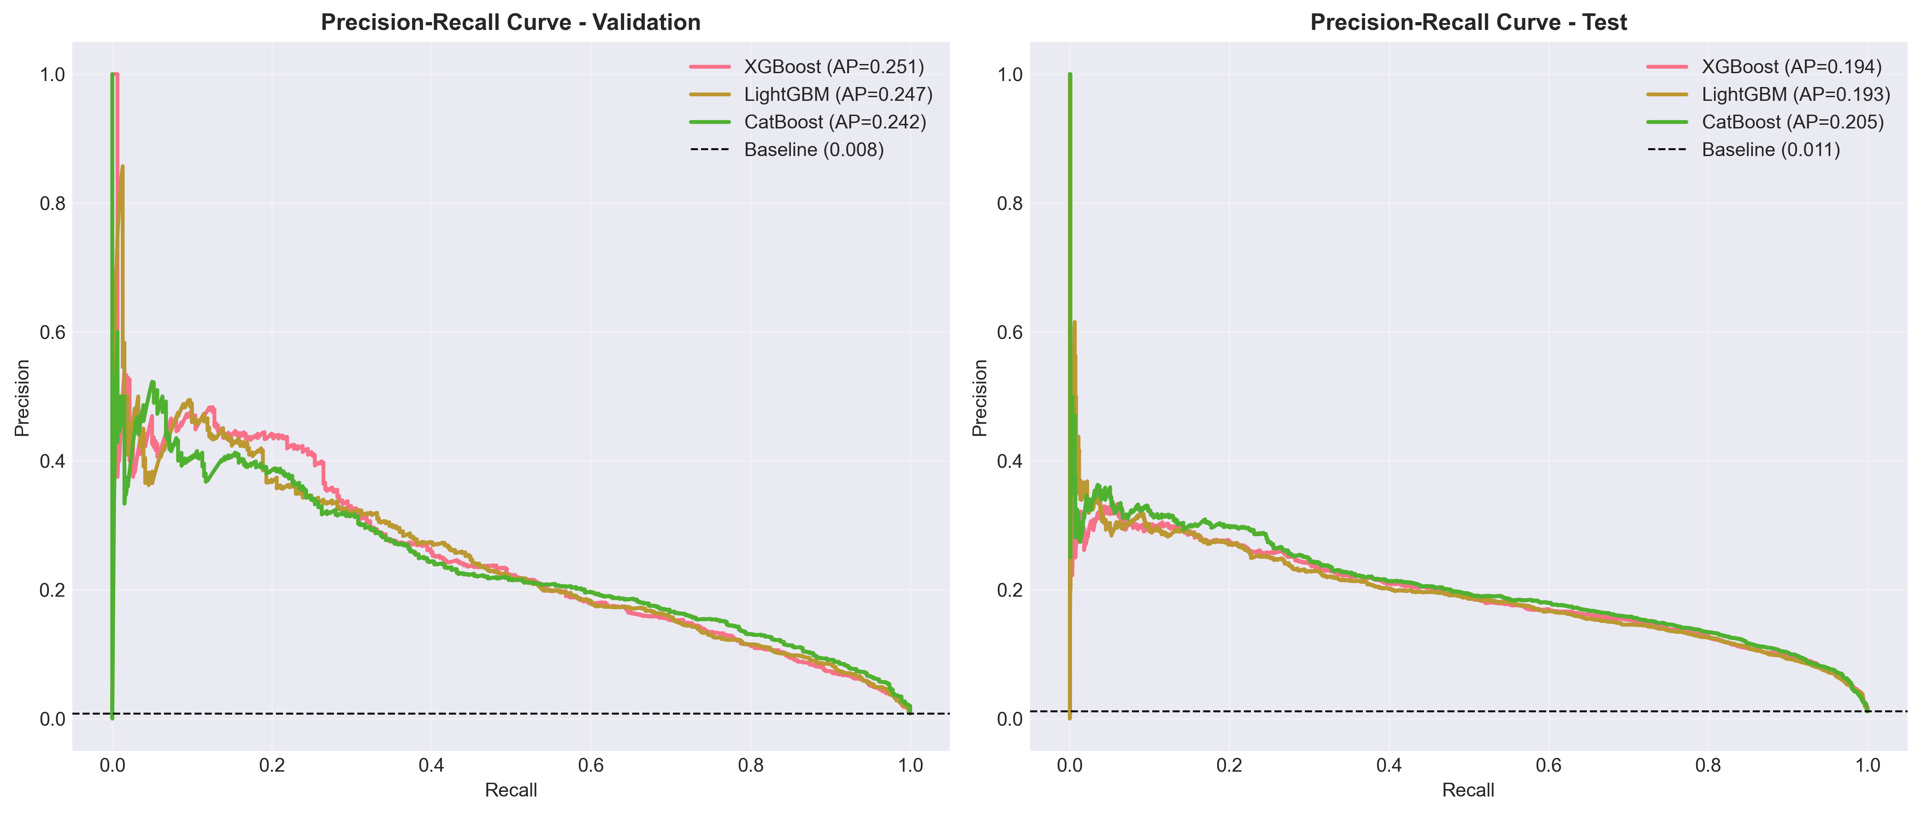
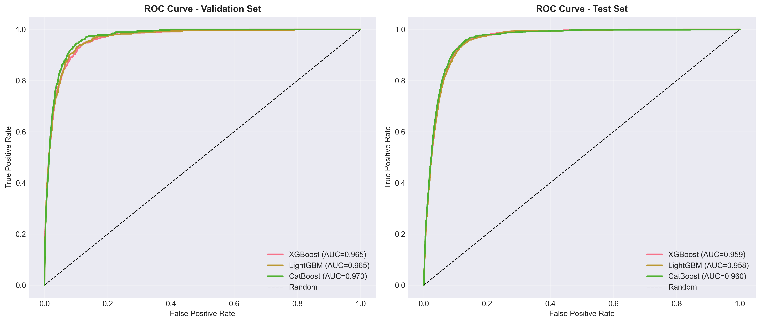
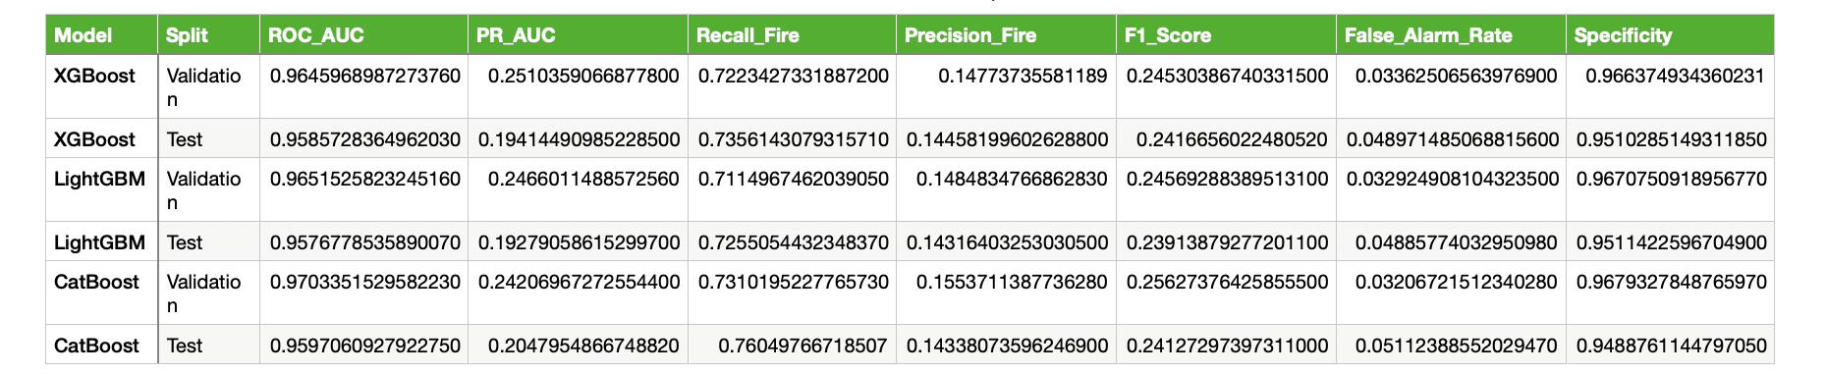
Task Accomplished
7.5.c Model Selection Strategy - Gradient Boosting models : XGBoost , LightGBM , CatBoost
[ Figure 7.4.b.ii : ROC curve / Precision- Recall Curve test – Gradient Boosting Model ]
[ Table no 7.5.c : Evaluation metrices – Gradient Boosting Model ]​

Slide 22
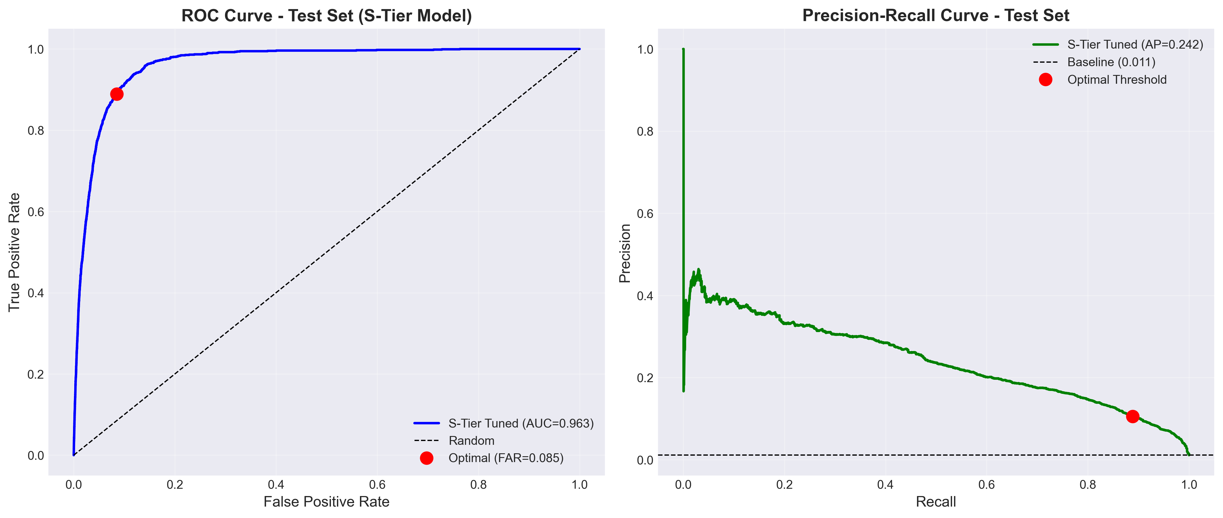
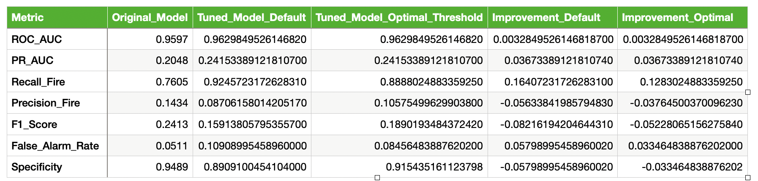
Task Accomplished
7.5.d Model Evaluation : FFOPM Model
Default Threshold (0.5):
Average Accuracy: 0.9087 (90.87%)
Average Log Loss: 0.2141
Optimal Threshold (0.6569):
Average Accuracy: 0.9324 (93.24%)
Average Log Loss: 0.2141
[ Table no 7.5.d : Evaluation metrices of final FFOPM Model ]​

Slide 23
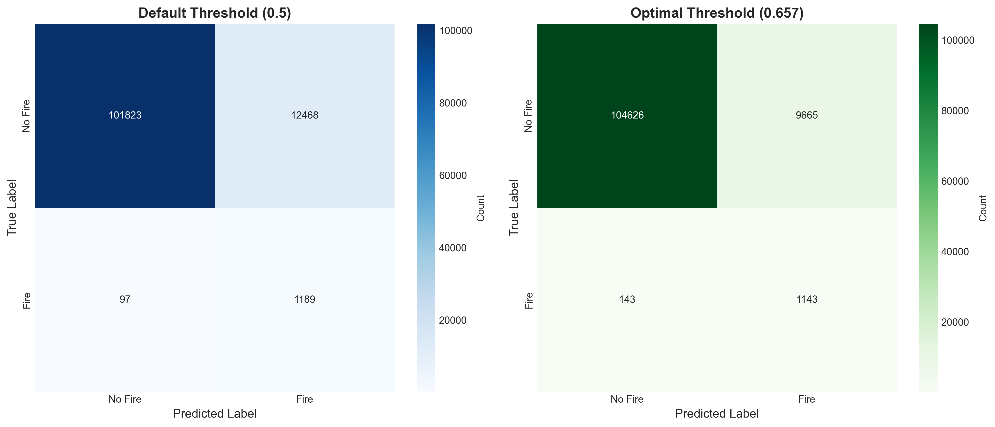
Task Accomplished
[ Figure 7.5.d : Confusion Matrix – FFOPM Model ]

Slide 24
Task Remaining
FFSFM Model Development
FFSFM Model Hyperparameter tuning
FFSFM Model Deployment
FFSFM and System Integration

Slide 25
References
[1] A. Shrestha, "Nepal’s forests in peril as wildfire incidents surge," The Kathmandu Post, May 2024. [Online]. Accessed: May 2024.
[2] Nepal Community, "Discussion on the 2024 wildfire season and its impacts," Reddit, 2024. [Online]. Available: https://www.reddit.com/r/Nepal/. Accessed: May 2024.
[3] A. Yilmaz and L. Chen, "A comparative analysis of machine learning models for forest fire susceptibility mapping in the Antalya region," Remote Sens. Environ., vol. 123, Art. no. 101234, 2022.
[4] R. Gupta and S. Kumar, "Explainable AI for wildfire risk prediction: A hybrid XGBoost and SHAP approach," Forests, vol. 14, no. 5, Art. no. 890, 2023.
[5] R. Xu, J. Li, and Y. Chen, "A forest fire detection system based on ensemble learning," J. Remote Sens. Appl., vol. 15, pp. 112–125, 2023.
[6] X. Sun et al., "A forest fire prediction model based on cellular automata and machine learning," IEEE Access, vol. 12, pp. 55389–55403, 2024.

Slide 26
References
[7] Y. Xie and L. Peng, "Ensemble learning methods for burned area prediction in California and Portugal forests," Int. J. Wildland Fire, vol. 32, pp. 450–465, 2023.
[8] M. Haydar, A. H. Rafi, M. K. H. Khan, S. Hosan, and H. Sadia, "Mapping climate change induced forest fire susceptibility using tree-based machine learning algorithms in Bangladesh," Ecol. Indic., vol. 176, Art. no. 113657, 2025.
[9] H. Hannane, M. El-Meziani, and M. C. Bakkay, "Satellite data for forest fire detection using deep learning," Int. J. Adv. Trends Computer. Sci. Eng., vol. 12, no. 1, 2023.

Slide 27
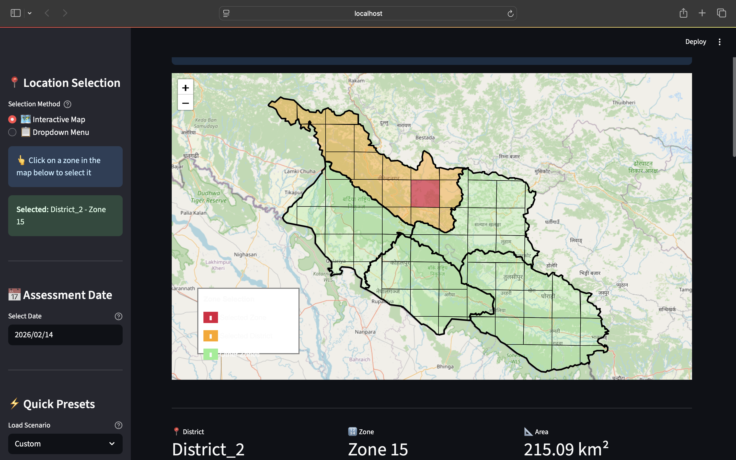
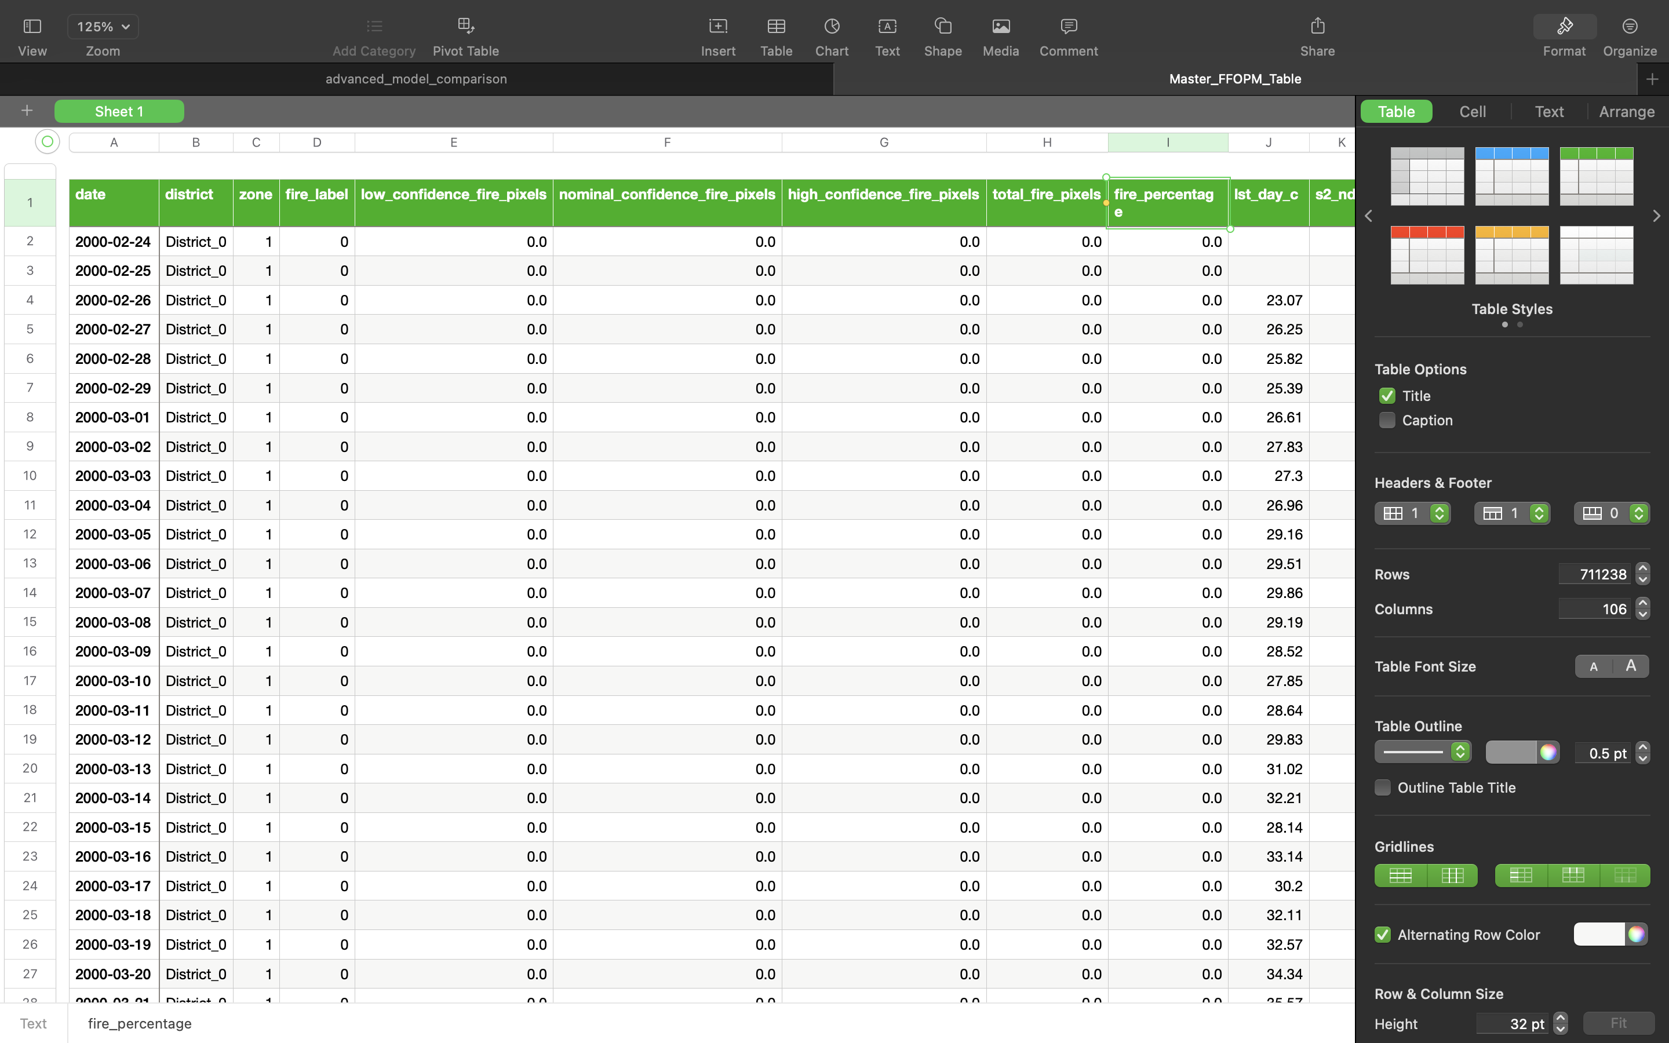
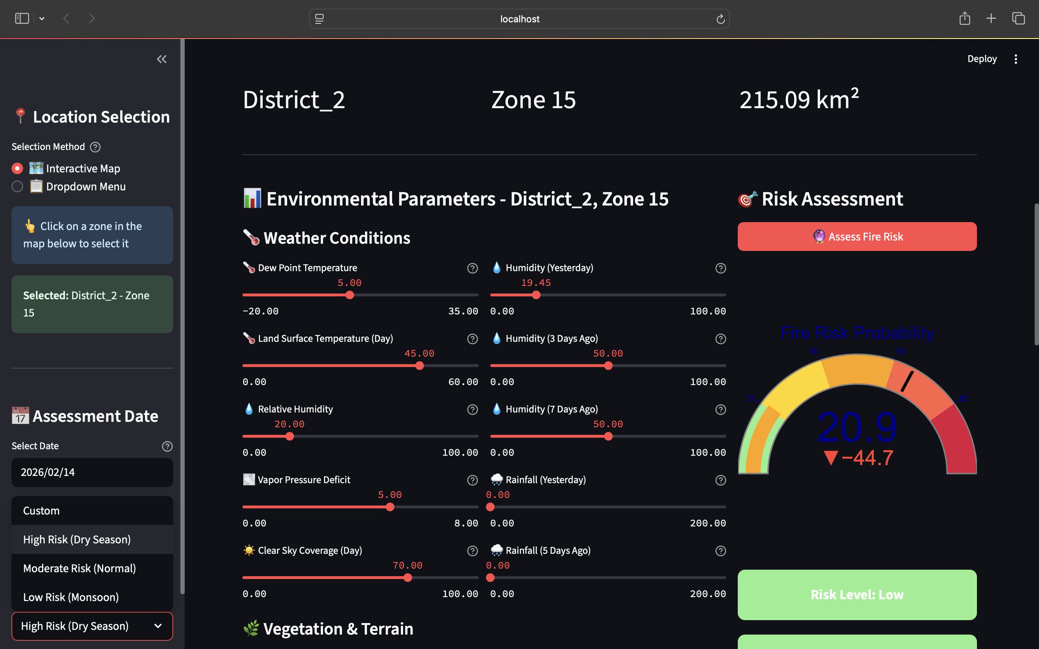
Appendix
Figure 9.1 : No Fire / Fire Satellite Image
Figure 9.1 : Master CSV Parameters Data

Slide 28
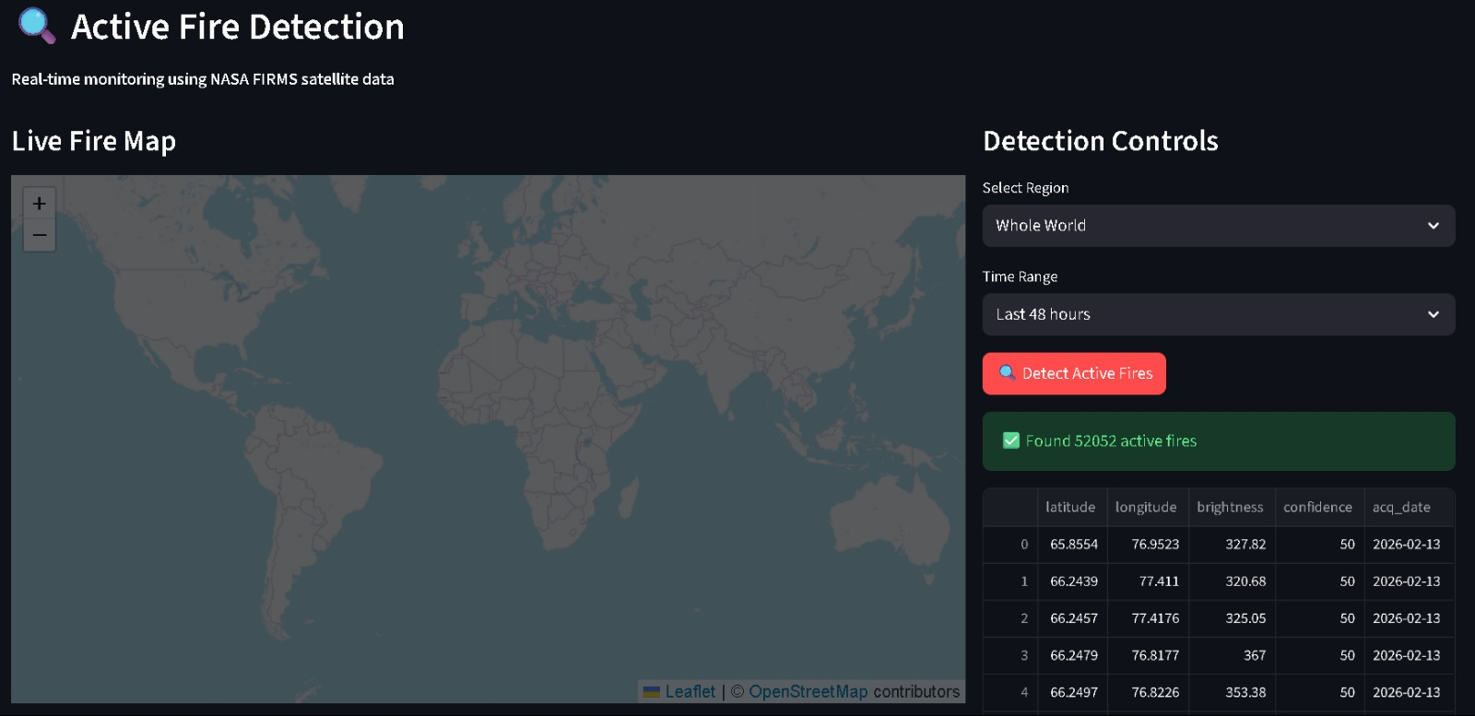
Appendix
Figure 9.3 : Active Fire Detection – live fire map

Slide 29
Queries?
Thank YOU!!

